Slide 1

Puducherry Technological University
Department of Information Technology
AGRITWIN-GH: SMART AGRICULTURE TWIN FOR PRECISION GREENHOUSE HORTICULTURE
Under the Supervision of
Dr. V. Govindasamy
Professor
Department of Information Technology
Puducherry Technological University
Project By
Mr. Arjun Christopher S (Reg No : 2201112007)
Miss. Bhuvanalakshmi J P (Reg No : 2201112009)
Miss. Vantapati Raja Rajeswari (Reg No : 2201112052)

Slide 2
Agenda
Abstract
Introduction to AgriTwin-GH
Project Objectives
Literature Survey
Inference from Literature Survey
Proposed Project “AgriTwin-GH: Smart Agriculture Twin for Precision Greenhouse Horticulture”
High-Level Architecture Diagram
Input Data and Expected Output
Project Modules
Module – I: Unified Data Processing
Module – II: Predictive Analytics & Classification
Module – III: Digital Twin & Model Predictive Control
Implementation & System Requirements
Project Development Timeline
Conclusion
Datasets
References

Slide 3
Abstract
High-value greenhouse crops such as tomato and strawberry require precise environmental control for high yield, quality, and early disease prevention.
Greenhouse cultivation enables year-round crop production by shielding plants from external climate variability, but it demands continuous monitoring and timely control decisions to avoid stress and disease outbreaks.
AgriTwin-GH is a software-based AI digital twin for precision greenhouse cultivation of tomato and strawberry using data-driven intelligent models.
Uses Short-term forecasting models predict greenhouse conditions, which are evaluated using a digital twin coupled with Model Predictive Control (MPC).
The system generates disease-aware predictions and simple non-verbal operational alerts for actionable greenhouse control.
Enhances crop yield and strengthens early disease prevention while simultaneously reducing the excessive use of water, energy, and fertilizers, thereby enabling a scalable and cost-effective decision-support framework.

Slide 4
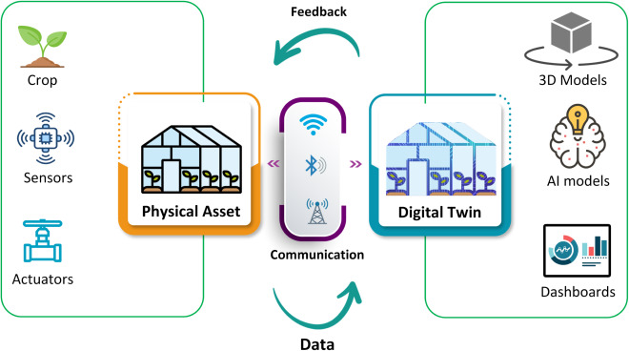
Introduction to AgriTwin-GH
Digital twins are virtual representations of physical systems that use data and models to mirror real-world behavior, enabling prediction, what-if analysis, and safe validation of control decisions.
Greenhouse cultivation is well suited due to controlled conditions, continuous data flow, and tightly coupled subsystems. AgriTwin-GH applies a software-based digital twin for tomato and strawberry greenhouses to support early risk awareness, worker-friendly alerts, and scalable deployment.
Fig. Conceptual Digital Twin Architecture for Greenhouse Cultivation

Slide 5
Project Objectives
To design and implement a software-based AI digital twin framework for intelligent greenhouse management, enabling predictive, adaptive, and data-driven control of environmental conditions.
To facilitate early disease risk identification and progression forecasting, while simultaneously optimizing the use of water, energy, fertilizer, and climate resources without violating crop safety and stress thresholds.
To develop a scalable and cost-effective decision-support system based on real agricultural datasets, delivering simple non-verbal operational alerts that minimize manual intervention and shift greenhouse operations from reactive to proactive management.

Slide 6
Literature Survey
S. No. | Title of Paper | Journal Title with Year of Publication & Author | Technical Description | Research Gap
1 | Greenhouse Industry 4.0 – Digital Twin Technology for Commercial Greenhouses | Energy Informatics, 2021 | Proposes an Industry 4.0–based digital twin ecosystem integrating IoT, AI, and big data to optimize greenhouse energy consumption, production scheduling, and resource utilization through virtual–physical synchronization. | • Digital twin does not include plant disease detection or crop health analytics. • Lacks adaptive learning to update the twin based on real-time crop stress or disease conditions.
2 | Optimal Strategy for Energy-Efficient Management of Greenhouse Climate Control | IEEE Open Access Journal of Power and Energy, 2025 | Develops a multi-objective optimization model to minimize energy cost and peak demand while controlling temperature, humidity, and CO₂ levels in greenhouse environments. | • Focuses only on energy optimization without considering disease-influenced microclimate variations. • Operates mainly on offline simulations without real-time crop-aware feedback.
3 | An Intelligent IoT-Based System Design for Controlling and Monitoring Greenhouse Temperature | IEEE Access, 2022 | Designs an IoT-based architecture using sensors and Petri Net models to monitor and regulate greenhouse temperature efficiently while reducing energy consumption. | • Limited to temperature control, ignoring multi-parameter crop health indicators. • No AI-based predictive mechanism for future environmental or crop risk forecasting.

Slide 7
Literature Survey (Contd..)
S. No. | Title of Paper | Journal Title with Year of Publication & Author | Technical Description | Research Gap
4 | Precision Agriculture Through Deep Learning: Tomato Plant Multiple Diseases Recognition with CNN and Improved YOLOv7 | IEEE Access, 2024 | Implements deep learning models (CNN and improved YOLOv7) for high-accuracy detection and classification of multiple tomato leaf diseases using image data. | • Functions as a standalone disease detection system without integration into greenhouse control systems. • Disease detection results are not used for automated decision-making or control actions.
5 | Designing AI-Driven Platforms to Transform Agricultural Ecosystems | International Journal for Research Publication and Seminar, 2025 | Proposes a modular AI-driven platform integrating IoT, machine learning, reinforcement learning, and explainable AI for end-to-end agricultural decision support. | • Platform lacks greenhouse-specific digital twin validation. • Does not integrate real-time disease detection with closed-loop control mechanisms.

Slide 8
Inference from Literature Survey
Digital Twin used mainly for energy and production optimization, not for plant health or disease intelligence, limiting agronomic decision depth.
Reactive control paradigm — system responds to operational conditions but does not anticipate disease onset or stress progression before symptoms appear.
No integration of plant image intelligence (CNN-based disease detection); crop health is inferred indirectly rather than visually validated.
Lacks temporal disease progression modeling — no sequence learning to forecast how disease risk evolves over time.
Alerts and decisions are system-centric, not human-centric — no non-verbal or intuitive signaling mechanism for on-field workers.
Resource optimization focuses heavily on energy markets, with limited emphasis on preventive water, fertilizer, and pesticide efficiency via early intervention.
Crop–environment–disease coupling is weak, treating climate, energy, and production as dominant layers while disease remains secondary.

Slide 9
Proposed Project - AgriTwin-GH
AgriTwin-GH introduces a software-based AI digital twin that integrates multi-parameter greenhouse data, disease intelligence, and short-term forecasting to enable predictive and safety-validated control for tomato and strawberry cultivation.
Key Differentiators
Digital Twin + AI Integration: Combines data-driven learning with virtual system simulation for safer decision-making.
Predictive, Not Reactive: Anticipates disease risk and environmental stress before visible symptoms appear.
Human-Centered Design: Uses non-verbal alerts suitable for illiterate or semi-literate workers.
Resource-Efficient Control: Reduces water, energy, and fertilizer waste through preventive actions.

Slide 10
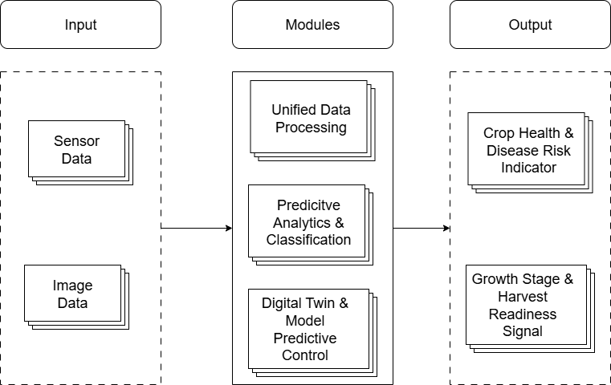
High-Level Architecture Diagram
Fig. High-Level Architecture Diagram for Proposed Project

Slide 11
Input Data and Expected Output
Inputs
Uses open greenhouse datasets as virtual sensor streams, eliminating dependency on physical sensors.
Time-series inputs include temperature, humidity, light intensity, CO₂, soil moisture, EC, and soil pH.
Incorporates labeled tomato and strawberry plant images covering growth stages and disease conditions.
Enables identification of diseases (powdery mildew, leaf scorch, leaf mold), growth stages, and fruit maturity.
Expected Output
Provides a unified assessment of plant health and disease likelihood.
Supports early disease awareness and preventive intervention.
Identifies current crop developmental stage.
Signals optimal harvest timing, especially critical for strawberries.
Improved resource optimization through predictive simulation.

Slide 12
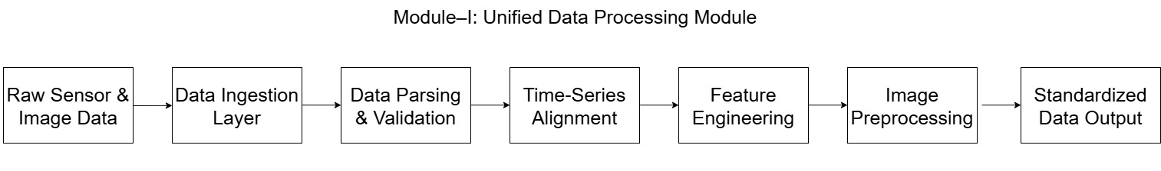
Project Modules
Module – I: Unified Data Processing
This module acts as the data preparation layer of the system. It converts raw open-source datasets into structured and usable inputs by processing environmental time-series data and plant image data. The module performs data cleaning, validation, and synchronization of heterogeneous time-series sources. It also normalizes and extracts relevant features for AI models and preprocesses images for disease analysis. Finally, it generates standardized data streams that support digital twin simulation and downstream analytics.
Fig. Module-Level Workflow of Unified Data Processing

Slide 13
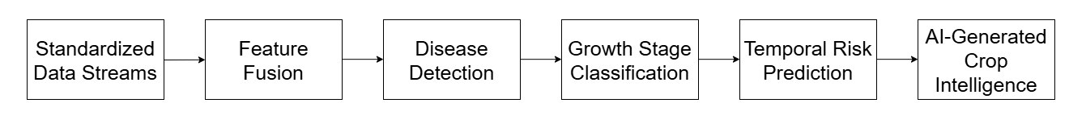
Project Modules (Contd..)
Module – II: Predictive Analytics & Classification
This module serves as the AI inference layer of the system. It applies convolutional neural network (CNN) models for plant disease detection using leaf images and uses temporal learning models to analyze crop growth patterns and disease progression over time. By combining sensor-based environmental data with image features, the module performs crop health classification and identifies crop growth stages and harvest readiness. It generates early disease risk indicators before visible symptoms appear and integrates multi-modal data to improve prediction accuracy. The reliable outputs produced by this module are forwarded to the digital twin layer for validation and control planning.
Fig. Module-Level Workflow of Predictive Analytics & Classification

Slide 14
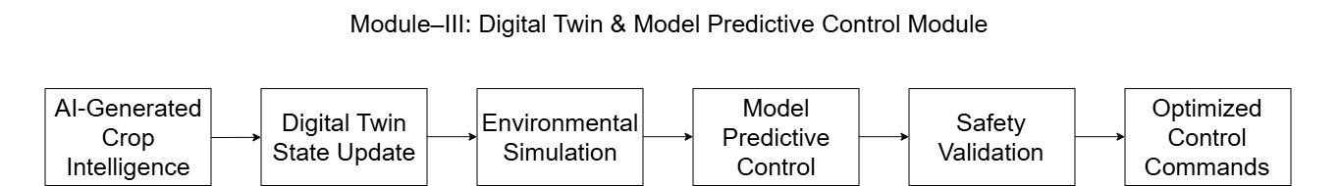
Project Modules (Contd..)
Module – III: Digital Twin & Model Predictive Control
This module represents a virtual replica of the greenhouse system built using data-driven models. It continuously maintains the virtual state of greenhouse climate and crop conditions and simulates system behavior under different control strategies. The module performs short-term forecasting of environmental conditions and evaluates alternative control actions through predictive control techniques. AI-generated decisions are validated through virtual simulation before execution to ensure stable and efficient greenhouse operation. By modeling interactions among climate, irrigation, and ventilation subsystems, this module improves decision reliability under uncertainty and supports informed greenhouse control.
Fig. Module-Level Workflow of Digital Twin & Model Predictive Control

Slide 15
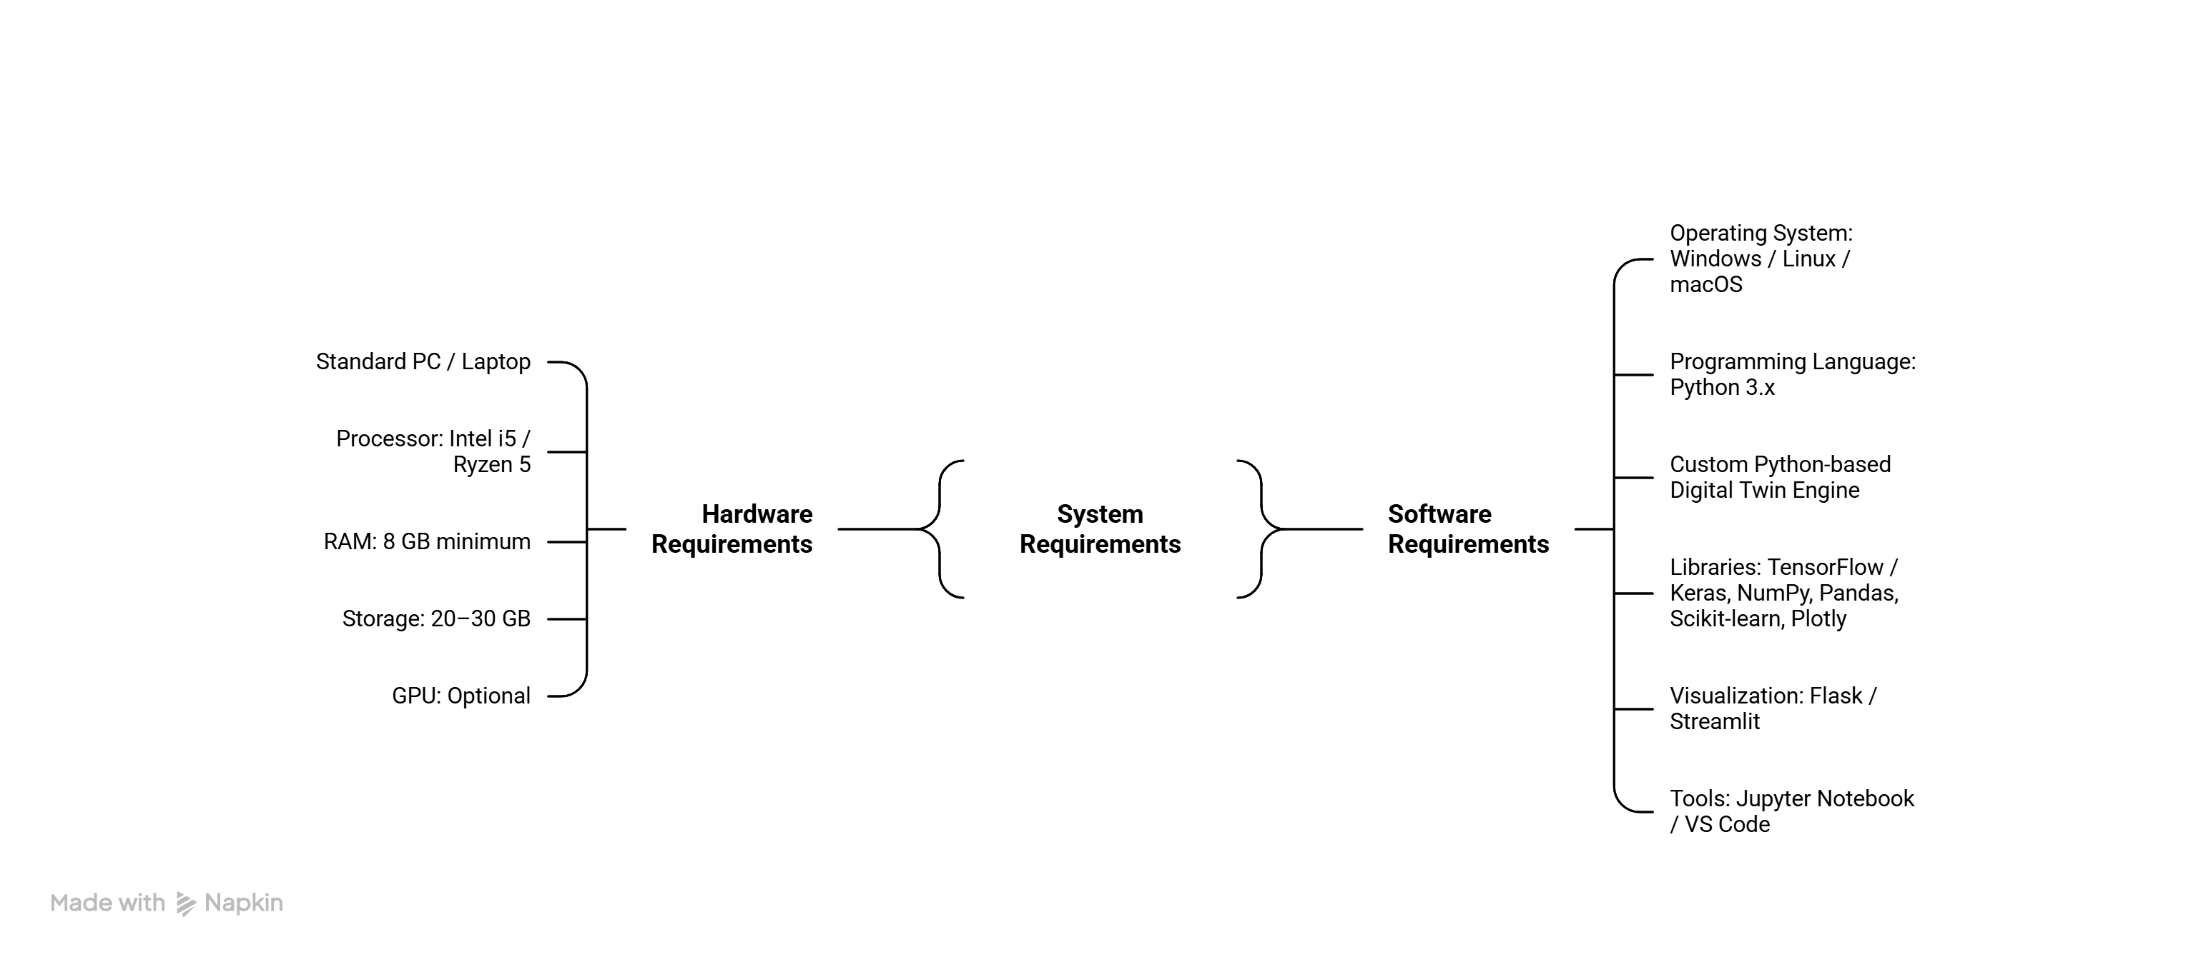
Implementation & System Requirements
Software-based Digital Twin greenhouse simulation.
Open-source time-series datasets used as virtual sensors.
Plant image datasets simulate real-time crop observation.
AI models executed in Python environment.
Digital Twin core performs prediction, risk analysis, and control simulation
Fig. Hardware & Software Requirements

Slide 16
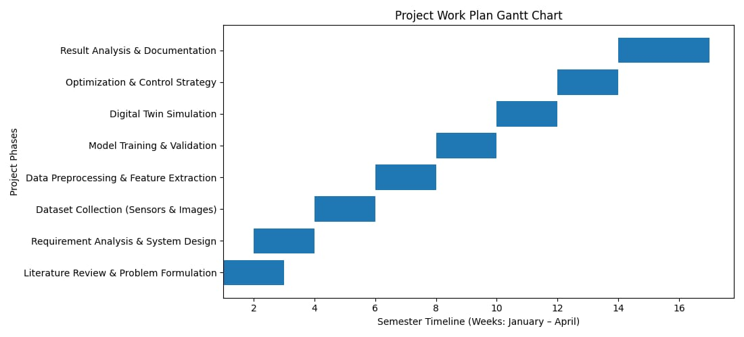
Project Development Timeline
Fig. Phase-wise Project Gantt Chart

Slide 17
Conclusion
AgriTwin-GH demonstrates the effectiveness of a software-based AI digital twin for intelligent greenhouse management of tomato and strawberry crops. By combining data-driven analytics, disease prediction, forecasting, and virtual system modeling, the digital twin enables predictive, disease-aware, and safety-validated control decisions before real-world execution.
The system shifts greenhouse operations from reactive manual control to proactive management, allowing early identification of environmental and disease risks. This leads to improved crop yield and quality while significantly reducing water, energy, and fertilizer wastage through optimized control actions.
Overall, AgriTwin-GH delivers a scalable, cost-effective, and sustainable decision-support framework for modern horticulture, highlighting the real-world impact of AI-driven digital twins in greenhouse farming.

Slide 18
Datasets
Greenhouse Plant Growth Metrics Dataset
Tabular time-series dataset containing greenhouse environmental and plant growth parameters. Used as virtual sensor data for climate modeling, forecasting, and digital twin simulation.
URL: https://www.kaggle.com/datasets/adilshamim8/greenhouse-plant-growth-metrics
Smart Agriculture Dataset
Sensor-based agricultural dataset with parameters such as temperature, humidity, and soil moisture. Supports environmental feature extraction, predictive analytics, and resource optimization.
URL: https://www.kaggle.com/datasets/chaitanyagopidesi/smart-agriculture-dataset/data
Tomato Plant Stages Dataset
Labeled tomato plant images representing different growth stages. Used for growth stage classification and temporal growth analysis.
URL: https://www.kaggle.com/datasets/arjunsudheer326/tomato-plant-stages-dataset
Ripe Strawberries Detection Dataset
Labeled strawberry images for ripeness and maturity detection. Used for harvest readiness prediction and fruit maturity assessment.
URL: https://www.kaggle.com/datasets/trainingdatapro/ripe-strawberries-detection

Slide 19
References
[1] M. Ghiasi, Z. Wang, M. Mehrandezh, and A. Mohammadi, “Optimal strategy for energy-efficient management of greenhouse climate control,” IEEE Open Access Journal of Power and Energy, vol. 12, pp. 1–14, December 5, 2025.
[2] D. A. Howard, Z. Ma, C. Veje, A. Clausen, J. M. Aaslyng, and B. N. Jørgensen, “Greenhouse industry 4.0 – digital twin technology for commercial greenhouses,” Energy Informatics, vol. 4, no. 1, pp. 1–20, May 2021.
[3] D. S. Joseph, P. M. Pawar, and K. Chakradeo, “Real-time plant disease dataset development and detection of plant disease using deep learning,” IEEE Access, vol. 11, pp. 1–15, 2023.
[4] A. Kaur and R. Kaur, “AI-enabled energy management for sustainable smart greenhouses: An integrated review,” Journal of Cleaner Production, vol. 382, pp. 1–15, 2024.
[5] D. K. Lee, B. K. Kang, Y. J. Kim, T. G. An, and Y. T. Chae, “A digital twin-based framework for precision tomato cultivation: Integrating XGBoost-based prediction with model predictive control,” SSRN Electronic Journal, 2024.
[6] S. R. Luna, M. P. García, and J. R. Torres, “Digital twin technology in greenhouse-based precision agriculture,” Computers and Electronics in Agriculture, vol. 209, pp. 107–119, 2023.

Slide 20
References (Contd..)
[7] B. V. Nikitha, N. K. S. Keerthan, P. Praneeth, and T. Amrita, “Leaf disease detection and classification,” Procedia Computer Science, vol. 218, pp. 291–300, January 2023.
[8] A. Oad, S. S. Abbas, A. Zafar, and others, “Plant leaf disease detection using ensemble learning and explainable AI,” IEEE Access, vol. 12, pp. 156038–156052, 2024.
[9] A. Soussi, E. Zero, C. D. C. Herrera, and others, “Integrating digital twins and model predictive control for sustainable greenhouse management in smart agriculture,” IEEE Transactions on AgriFood Electronics, vol. 1, no. 1, pp. 1–17, 2025.
[10] A. F. Subahi and K. E. Bouazza, “An intelligent IoT-based system design for controlling and monitoring greenhouse temperature,” IEEE Access, vol. 10, pp. 1–12, 2022.
[11] R. A. Tathed, “Designing AI-driven platforms to transform agricultural ecosystems,” International Journal for Research Publication and Seminar, vol. 16, no. 2, pp. 249–268, April–June 2025.
[12] M. Umar, S. Altaf, S. Ahmad, H. Mahmoud, A. S. N. Mohamed, and R. Ayub, “Precision agriculture through deep learning: Tomato plant multiple diseases recognition with CNN and improved YOLOv7,” IEEE Access, vol. 12, pp. 49167–49180, April 1, 2024.

Slide 21
Thank you

